Slide 1
Capstone Project II
Twitter Gender Prediction
Submitted by
Viki P. Yeole

Slide 2
Content
Objective
Problem Statement
About the dataset
Approach for this project
Optimization
Benefits to company
Key Learning

Slide 3
Objective
In this challenge we have a dataset of People tweeting on Twitter which includes around 20000 columns including Null values.
The goal of this challenge is to predict which gender is more active and trusted. Also we have to find which location is mostly used for tweeting.
We also have to find which algorithm can give maximum accuracy.

Slide 4
Problem Statement
Tweet Count:- For the finding person who is more active on twitter . Also who does more tweets.
Tweet Location and timezone:- which people are using for tweeting and what message they are giving here we can use it for people’s safety at some sensitive region.

Slide 5
About the dataset
Column | Description
unitid | unique id for user
trustedjudgments: | number of trusted judgments (int); always 3 for non-golden, and what may be a unique id for gold standard observations
lastjudgment_at | date and time of last contributor judgment; blank for gold standard observations
gender | one of male, female, or brand (for non-human profiles)
created | date and time when the profile was created.
description | the user's profile description
link_color: | the link color on the profile, as a hex value
tweet_coord | ( if the user has location turned on, the coordinates as a string with the format "[latitude, longitude]
tweet_created | when the random tweet (in the text column) was created

Slide 6
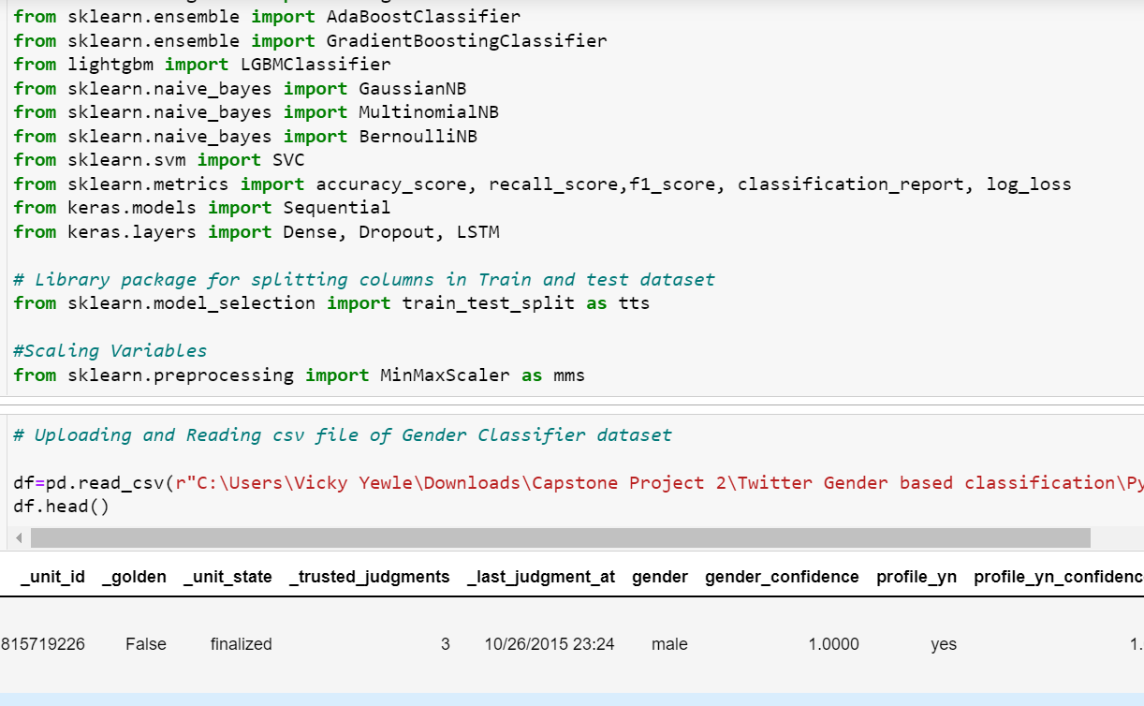
Approach for this project
Importing the dataset:-
First, We have imported libraries that are required for data cleaning and analysing, modeling, splitting.
Secondly we have imported dataset of Twitter Gender based Classification.

Slide 7
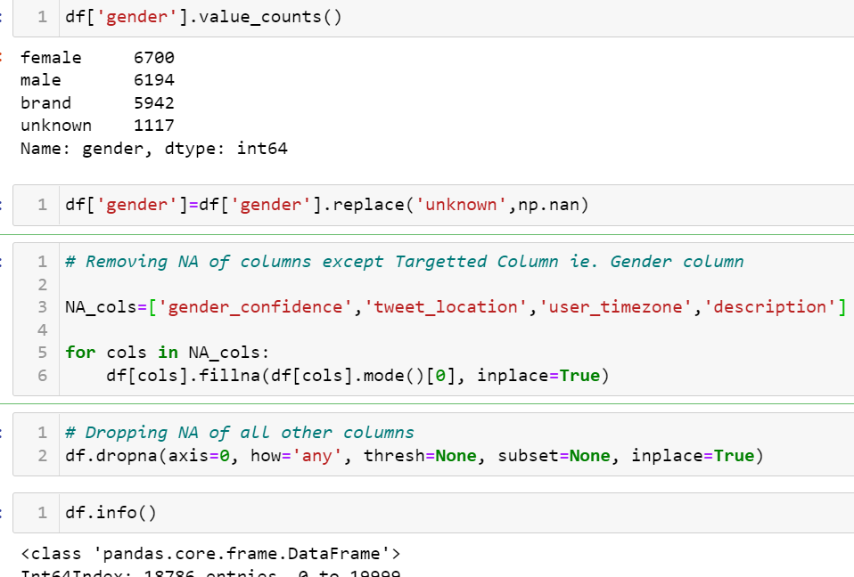
Approach for this project
Cleaning the dataset:-
Here we found that there are NA in some columns. Out of which in some columns like Gender we have to drop NA’s. In some columns like tweet_location, user_timezone, description we have to fill NA’s with Mode. ..Also some changes we have to make like
We have to change datatype and calculate the active hours, daily surfing time, active days from the day of profile created.
We have to work with description column because it is the only one which can tell us about gender of twitter users.
Clean the Description column with Neuro Linguistic Programing.

Slide 8
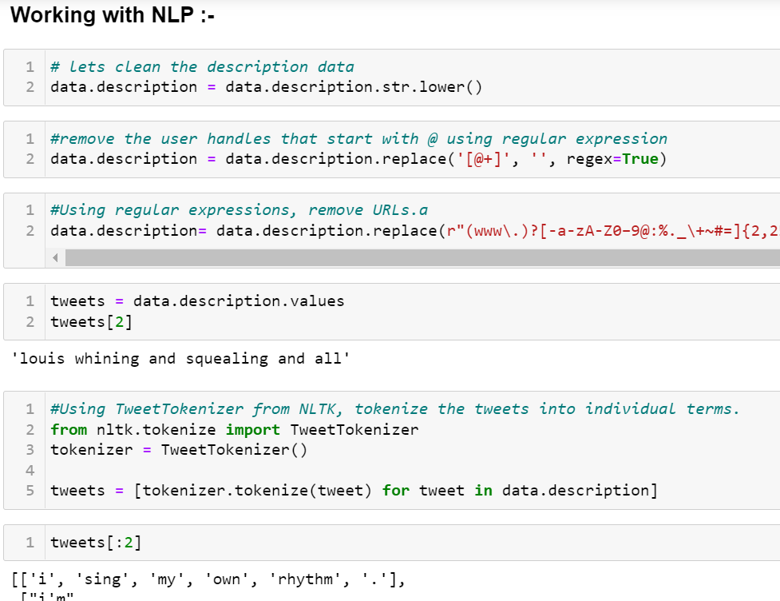
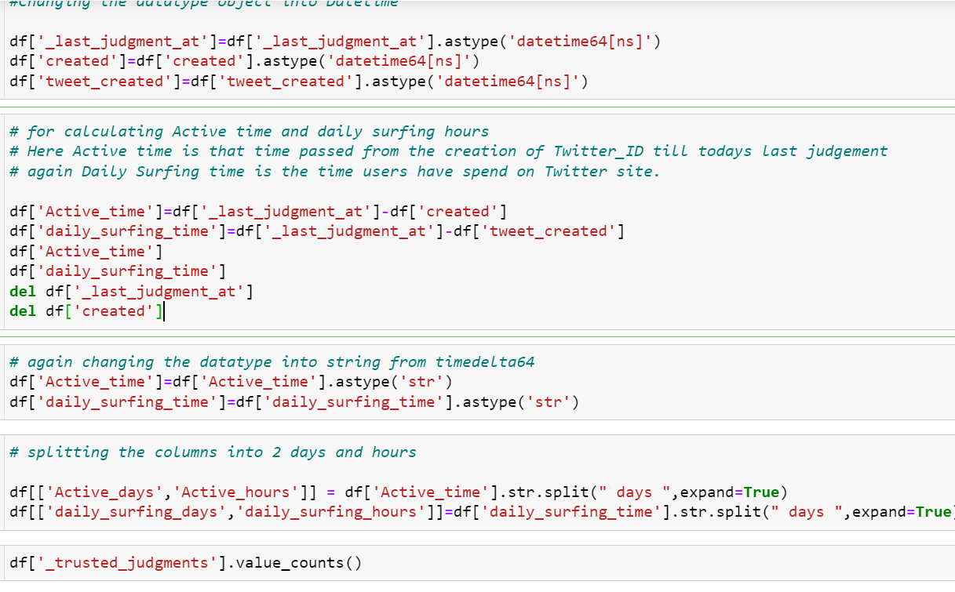
Approach for this project

Slide 9
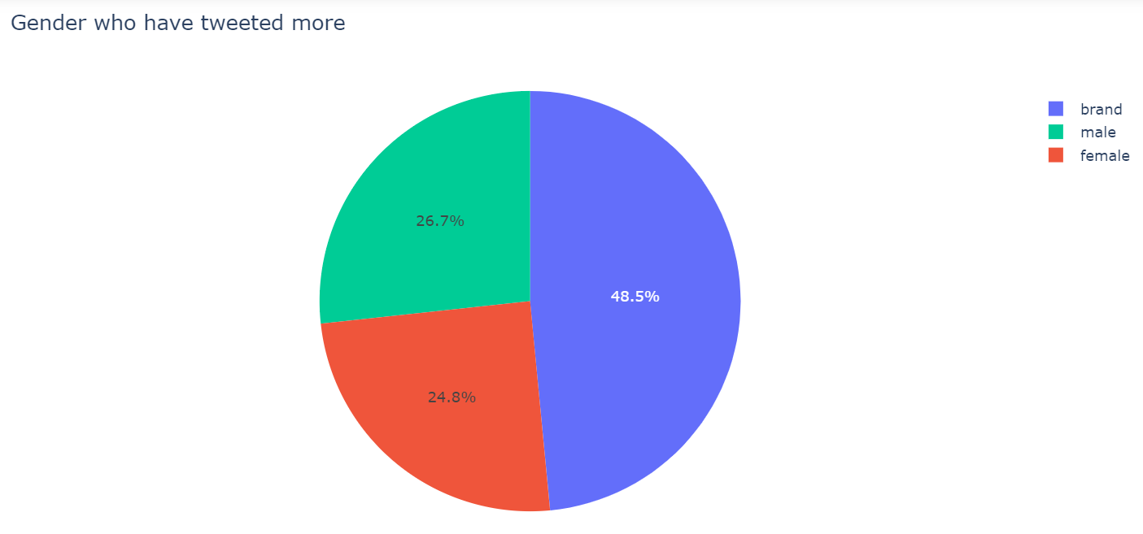
Approach for this Project
Here Next we have to do visualization and find out the insights of datasets.
We are finding Gender who have Tweeted More ?
Which gender is more active?
Gender which is surfing more daily
Gender which is retweeting more.
People from which tweet location are tweeting more

Slide 10
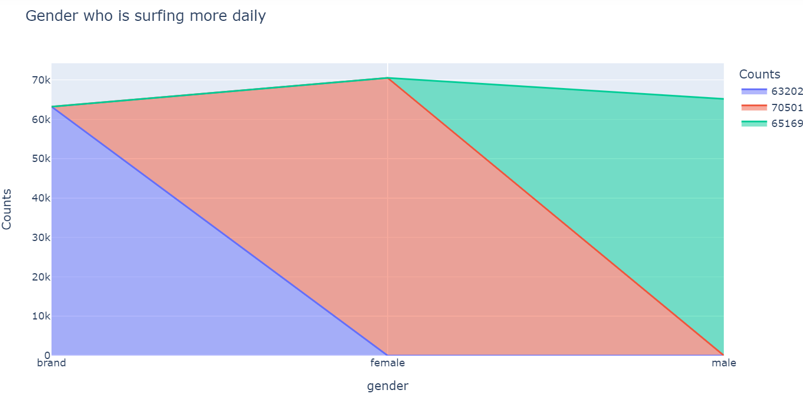
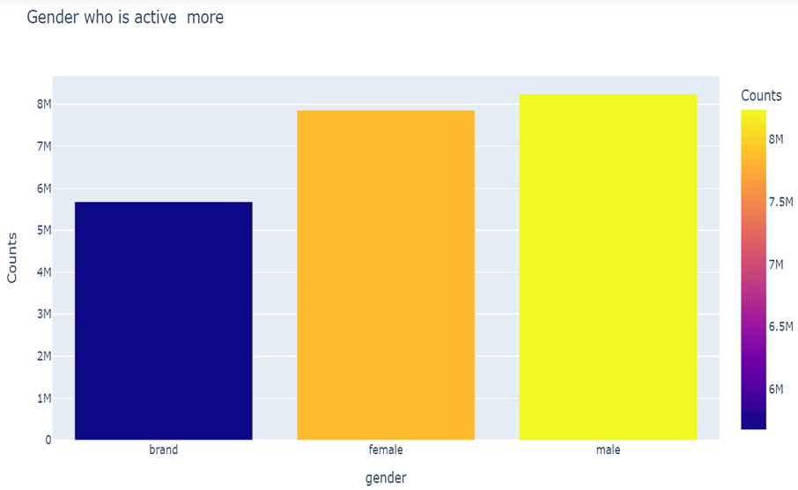
Approach for this Project

Slide 11
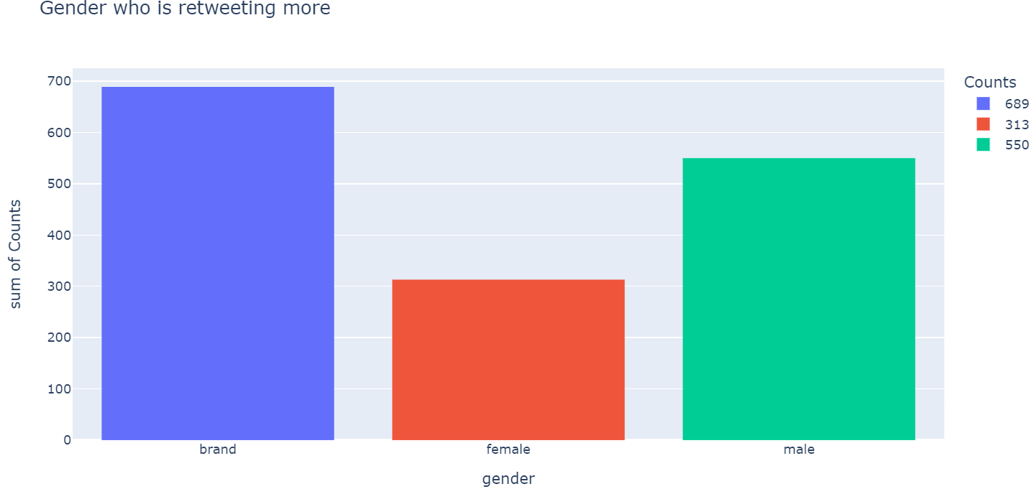
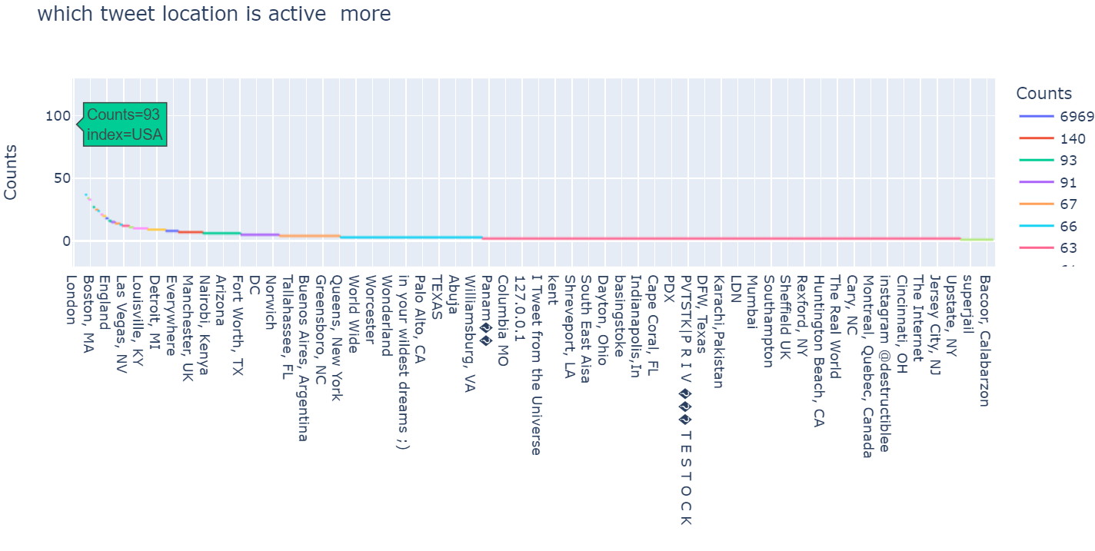
Approach for this Project

Slide 12
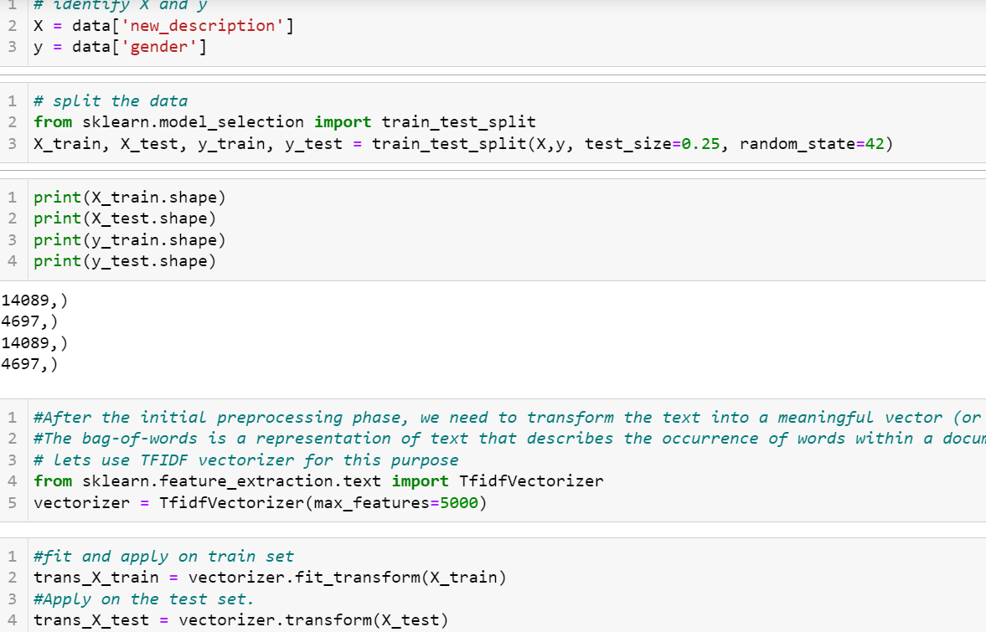
Approach for this project
Splitting of variable into dependent and independent Variables and Data into train and test set.
Converting the description into vector matrix of TF-IDF vector form…
Now lets run the model of ML algorithm and predict results

Slide 13
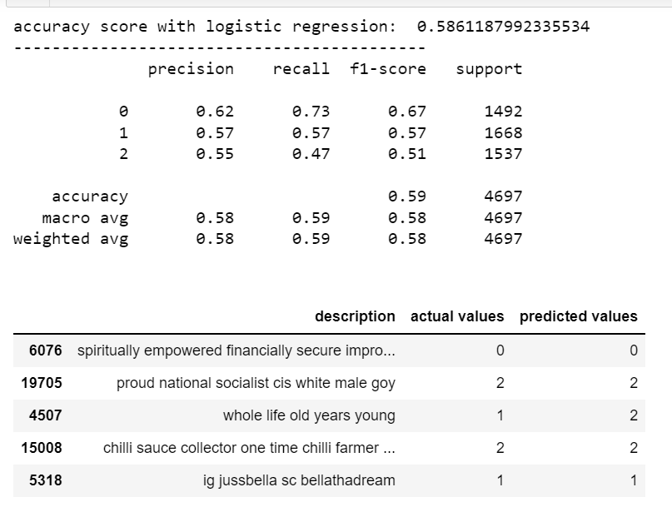
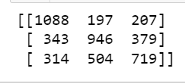
Approach for this project
So First we have run Logistic Regression and the result is as given
we got classification report, Accuracy score and Confusion matrix as given

Slide 14
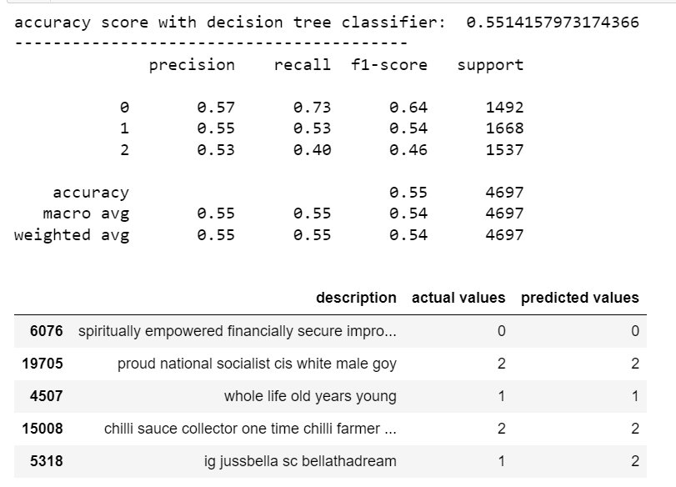
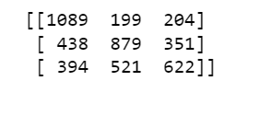
Approach for this project
Next we have run Decision Tree Classifier and the result is as given
we got classification report, Accuracy score and Confusion matrix as given

Slide 15
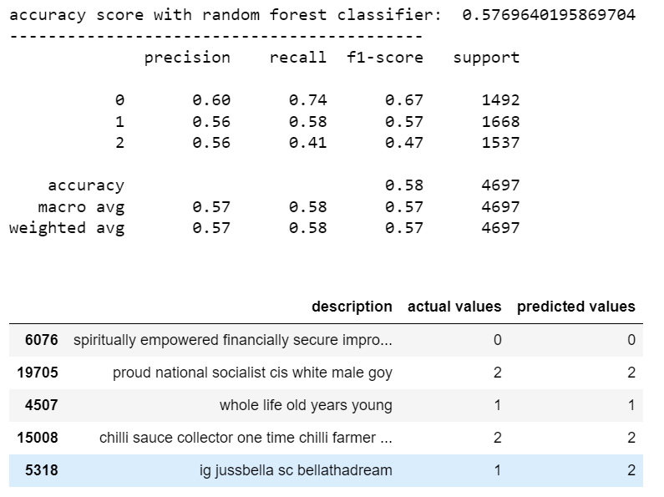
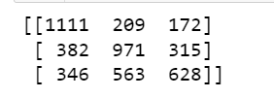
Approach for this project
So now we have run Random Forest Classifier Algorithm and the result is as given
we got classification report, Accuracy score and Confusion matrix as given

Slide 16
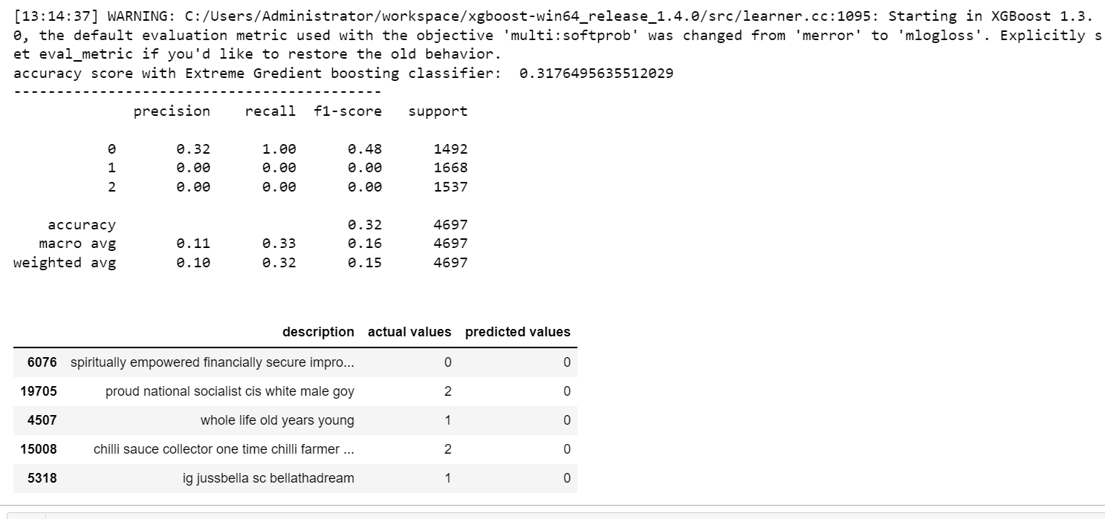
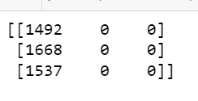
Approach for this project
So now we have run Extreme Gredient boosting Classifier Algorithm and the result is as given.
In this there is problem occurred that it has predicted only 1 value clearly.

Slide 17
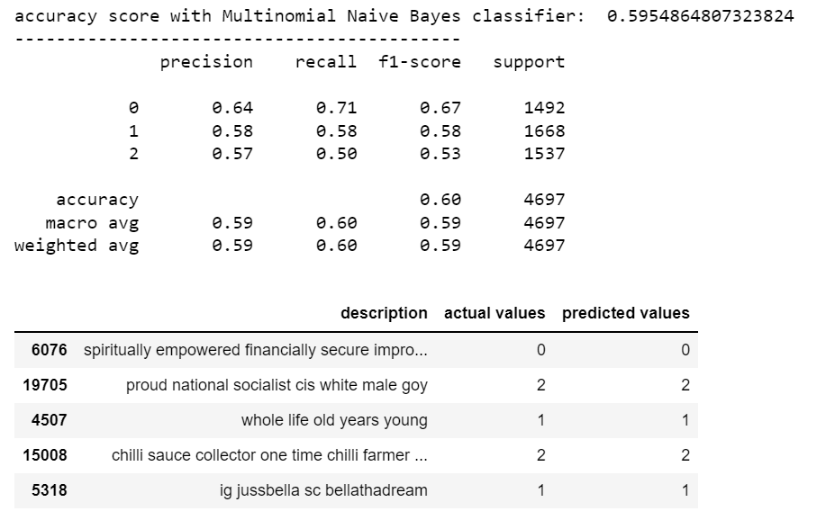
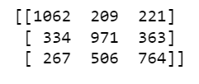
Approach for this project
So Now we have run Naïve bayes Classifier and the result is as given for Multinomial classifier have good accuracy than gaussian and binomial naïve bayes.

Slide 18
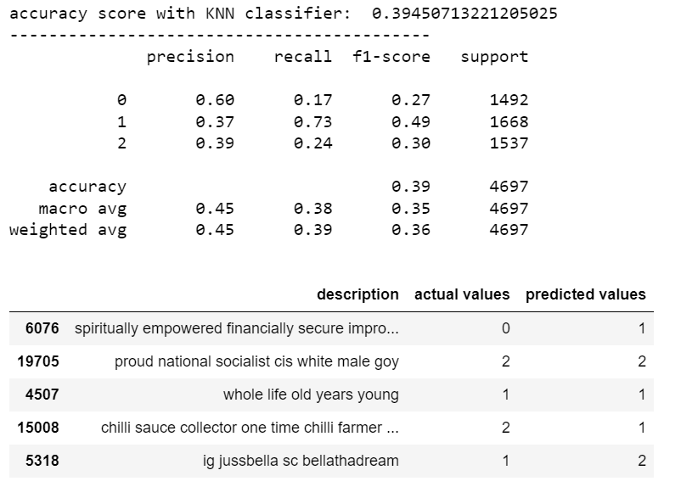

Approach for this project
So Now we have run KNN Classifier and the result is as given

Slide 19
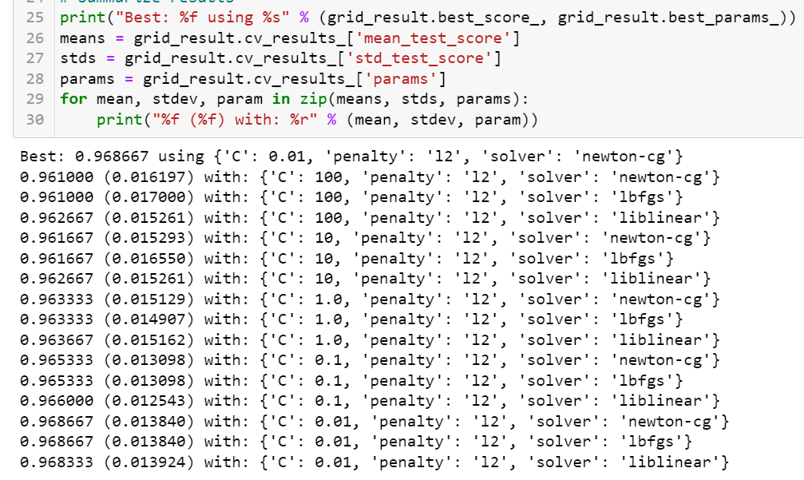
Optimization
Here we have done hyper tuning in Logistic Regression
As we get very low accuracy, we have done hyper parameter tuning by following parameters:-
solvers = ['newton-cg', 'lbfgs', 'liblinear’]
penalty = ['l2’]
c_values = [100, 10, 1.0, 0.1, 0.01]

Slide 20
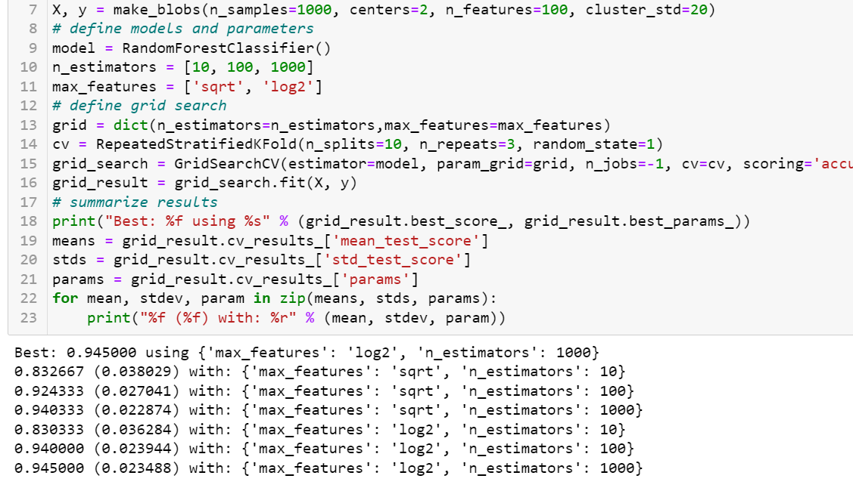
Optimization
Here we got Result of Random forest after optimizing result by following :-
n_estimators = [10, 100, 1000]
max_features = ['sqrt', 'log2']

Slide 21
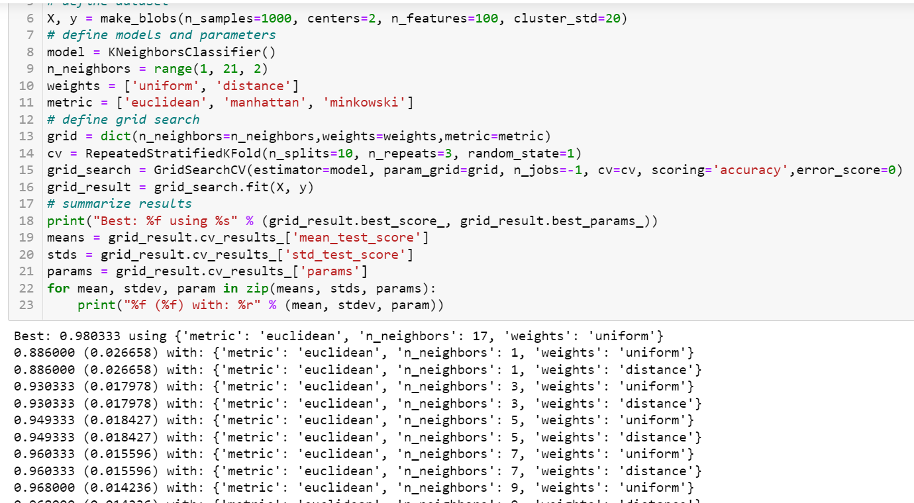
Optimization
Here we got Result of KNN after optimizing result by following :-
n_neighbors = [10, 100, 1000]
Weights= [‘uniform’,’distance’]
Metric= ['euclidean', 'manhattan', 'minkowski']

Slide 22
Key learnings
From this project as we have found that max Tweets are done by gender “Brand” Followed by “male” Gender.
Users from male gender are active from many days followed by female and Brand.
Users from Female Gender are daily surfing more than male and brand
Brands are more retweeting than female and male
Lastly People from London Location are active more than other Locations.
We got very good accuracy after hyperparameter tuning in KNN algorithm followed by Logistic Regression and Random forest

Slide 23
Benefits of this project
This helps other companies to promote their brands by contacting on twitter to Brand category
This is beneficial for those companies who are from London or who wants to grow in London as max users are preferring it

